Slide 1
FUTURISM
“Our greatest motivation in life comes from not knowing the future.”
So we create art of what we think it will be or how it should be
-Thomas Frey (Futurist)

Slide 2
Futurism started in Italy
They were interested in advancement in
mechanized society and destruction of all
symbols of the past (museums, academies,
And large cities)
Felt they held up progress
Favorite word “dynamism”
-shows “lines of force” that represent certain
objects

Slide 3
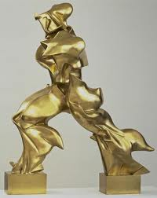
Futurism
Dynamism
Speed
Energy
Machine power
Vitality
Change
Restlessness of
Motion

Slide 4
Joseph Stella
Italian, travels to America at 25
He lives in New York before returning to his home land
NYC inspires Stella’s works of art
His works show his concern for symmetry and design in how the
different parts of the painting relates to one another

Slide 5
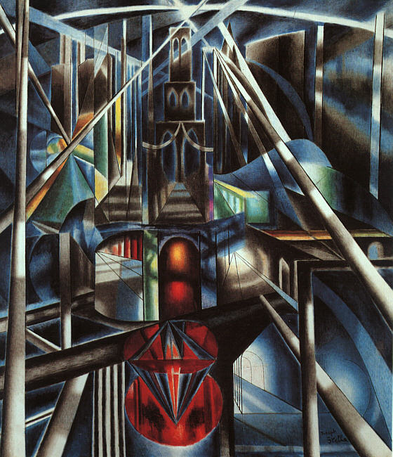
Brooklyn Bridge, 1918
Dynamic
Symmetrical
Balanced
Lights
Color
Perspective
Iconic city image

Slide 6
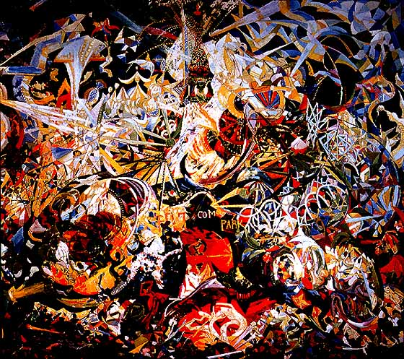
Battle of Lights
Fast
Commotion
Crowed
Lights
Loud
Busy
Movement

Slide 7
DE STIJL (da stay el)
Dutch for “the style”
ADVOCATED:
Nonrepresentational art, and the elimination of all
Feeling and emotion (complete opposite of expressionism)
Form is reduced to line or shape
Color is reduced to the primary colors (RED, BLUE, YELLOW)

Slide 8
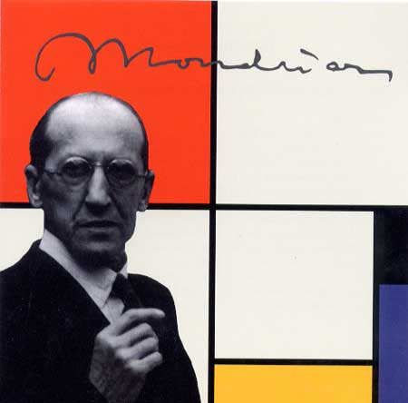
PIET MONDRIAN
Flattened natural forms and
reduced them to linear patterns
The colors Mondrian chose as
“purest” were the primaries

Slide 9
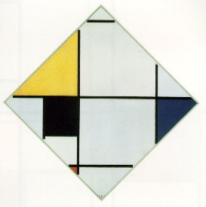
Diagonal Composition, 1921
Wanted to evoke the unity
and order of nature by:
Eliminating any false
Representation
Every space a different size
every white a different
shade of light grey
“Art systematically
Eliminates the world of
Nature and man”

Slide 10
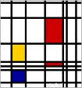
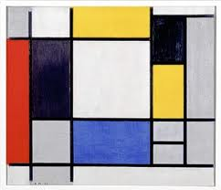
CREATE YOUR OWN MONDRIAN INSPIRED ART WORK
Keep in mind:
Line
Perspective
Depth
Primaries only
Organization
Simplicity
Uniformity

