Slide 1
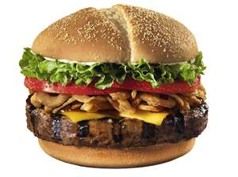
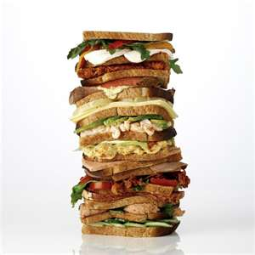
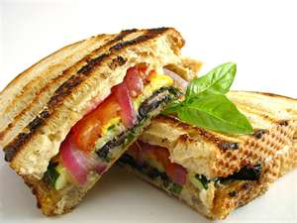
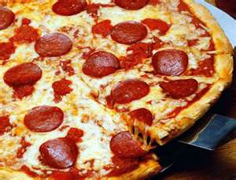
SANDWICHES
HANDHELD DELIGHTS

Slide 2
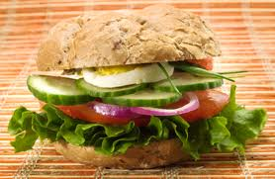
3 ELEMENTS
BREAD
SPREAD
FILLING

Slide 3
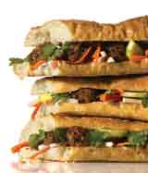
TYPES
HOT
COLD
CAN BE OPEN OR CLOSED-FACED
THERE IS A METHOD TO THE MADNESS

Slide 4
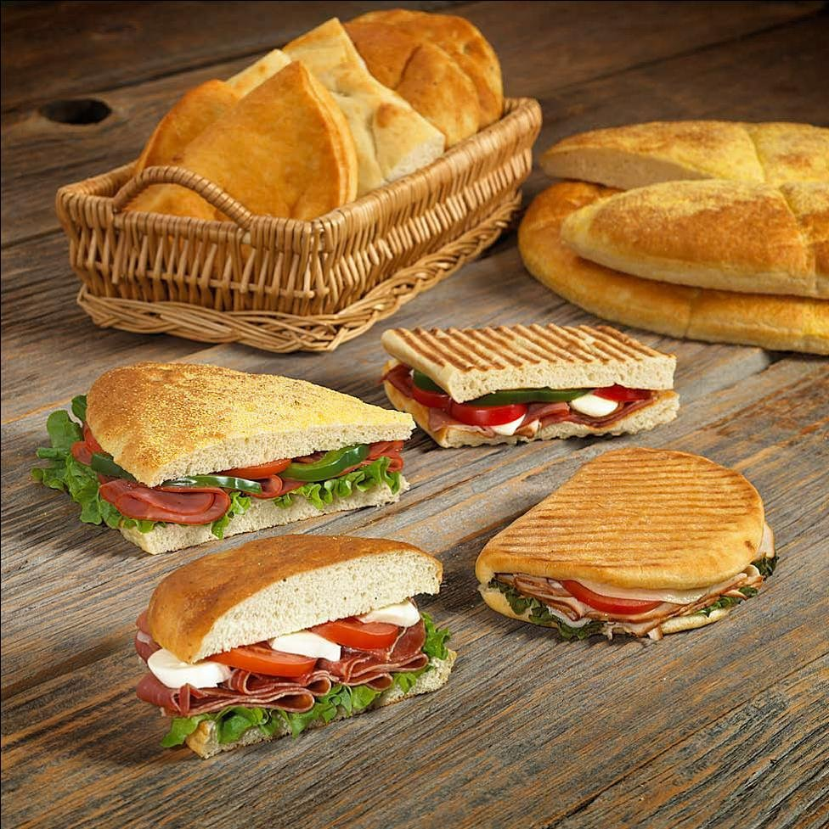
BREAD
DARE TO BE
DIFFERENT
EDIBLE CASING
TEXTURE FACTOR:
CRUSTY IS GOOD
FRESHNESS
BREAD MUST STAY TOGETHER……
WHAT ARE YOUR FAVORITE BREADS?

Slide 5
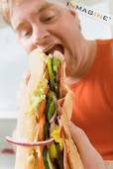

FILLING
THE HEART OF THE MATTER
PREDOMINANT FLAVOR THAT PROVIDES COMPLEXITY
COOKED/SLICED/PRE-MADE
1/3 TO ½ TOTAL WEIGHT OF SANDWICH
KEEP FILLING SECURE

Slide 6
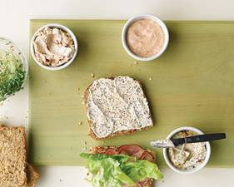
SPREADS-THE DRESSING.
SEALANT
FLAVOR
MOISTURE
WANT PROPER COVERAGE AND SPREADABILITY

Slide 7
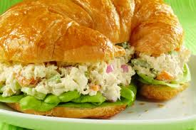
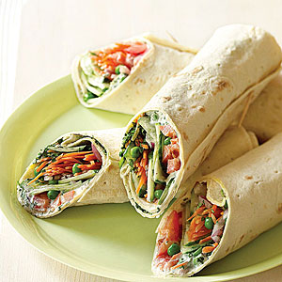
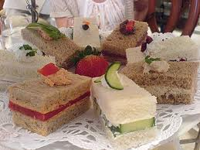
SANDWICH EXAMPLES
OPEN-FACED
WRAPS
CLOSED
FINGER
SANDWICHES

Slide 8
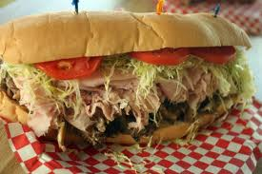
FAMOUS SANDWICHES
PO’ BOY
MONTE CRISTO
REUBEN
FRENCH DIP
PHILLY CHEESESTEAK
HOAGIE/ SUB
CROQUE MONSEUR
SLOPPY JOE
BLT
PB &J!
CLUB
GRILLED CHEESE
PEC
HOT DOG
HAMBURGER
GYRO
HISTORY

Slide 9
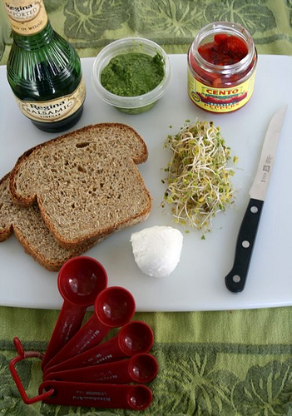
MISE EN PLACE
SET UP FOR EFFICIENCY
PREPARE ALL
INGREDIENTS
ARRANGE INGREDIENTS
SELECT AND ARRANGE
TOOLS
PREPARE
ACCOMPANIMENTS

Slide 10
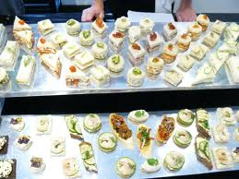
PRESENTATION
CUTTING
PLATING
SIDES
GARNISH

Slide 11
SANDWICH SANITATION
WHETHER HOT OR COLD, THEY CAN BE A DANGEROUS ENVIRONMENT FOR FOOD-BORNE ILLNESS
MIX OF PROTEINS, VEGETABLES, MAYONNAISE COMBINED WITH KITCHEN TOOLS…DANGER
BE AWARE AND MINDFUL OF HANDS AND SURFACES

Slide 12
THE CULTURE OF SANDWICHES
sandwich song
WHAT DOES THE SANDWICH SAY ABOUT HUMAN CULTURE?

