Slide 1
MyPlate
MyPlate was released in June 2011 to replace
The food pyramid.
Recommendations are for 2 years of age and older.
ORIGIN

Slide 2
MYPLATE
OBJECTIVE: TO LIST THE REQUIREMENTS AND SERVING SUGGESTION OF THE USDA USING THE MYPLATE FORMAT.
WARM-UP
MAKE A LIST OF FOOD GROUPS FOR OUR DIET
WRITE DOWN WHAT YOU ATE FOR LUNCH OR DINNER. DO YOU THINK YOU HAVE SATISFIED THE DIETARY REQUIREMENTS?
LET’S FIND OUT!

Slide 3
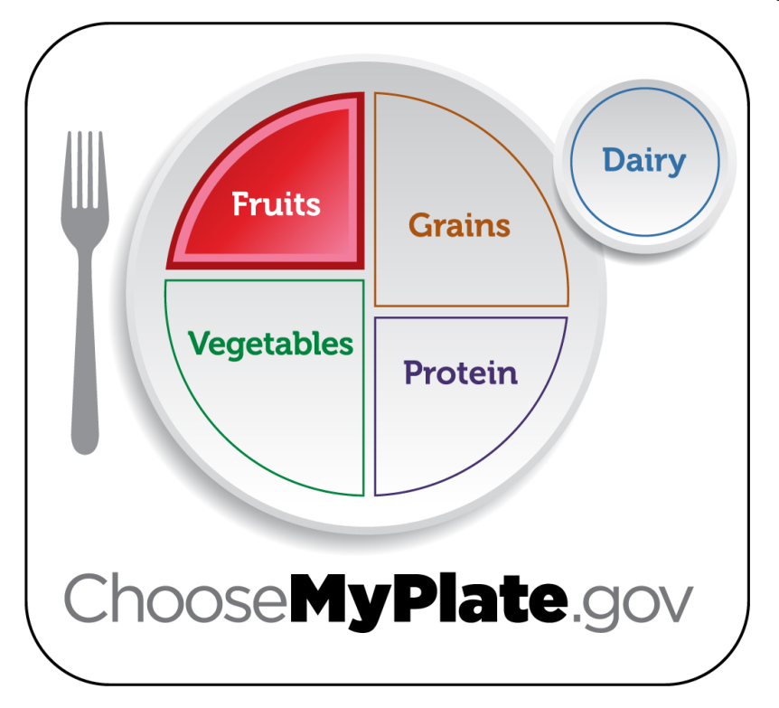
Fruits Group
Use fruits as snacks, salads or desserts.
Choose whole or cut up fruits more often than fruit juice.
Key Consumer Message:
Make half your plate fruits and vegetables.
Boys 9-13 | 1 ½ c. daily
Boys 14-18 | 2 c. daily
Girls 9-18 | 1 ½ c. daily
Notes:
Any fruit or 100% fruit juice counts as part of the fruit group. Fruits may be fresh, canned, frozen or dried. They may be whole, cut up or pureed.
*The serving amounts indicated on the chart above are appropriate for individuals who get less than 30 minutes per day of moderate physical exercise beyond normal daily activities. Those who are more physically active may be able to consumer more while staying within calorie needs.

Slide 4
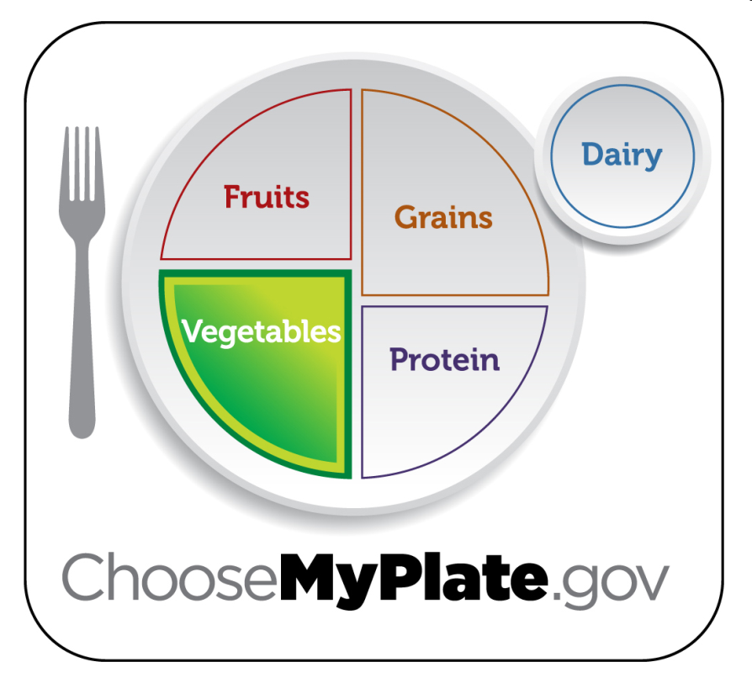
Vegetables Group
Choose fresh, frozen, canned or dried.
Eat red, orange and dark green vegetables.
Key Consumer Message:
Make half your plate fruits and vegetables.
Boys 9-13 | 2 ½ c. daily
Boys 14-18 | 3 c. daily
Girls 9-13 | 2 c. daily
Girls 14-18 | 2 ½ c. daily
Notes:
Any vegetable or 100% vegetable juice counts as a member of the vegetable group. Vegetables may be raw or cooked, fresh, frozen, canned or dried/dehydrated. They may be whole, cut up or mashed.
Vegetables are organized into five sub-groups based on their nutrient content:
Dark Green Vegetables: broccoli, dark green leafy lettuce, spinach
Red and Orange Vegetables: squash, carrots, pumpkin, tomatoes, red peppers, sweet potatoes
Beans and Peas: black beans, pinto beans, kidney beans, soy beans, lentil beans, split peas
Starchy Vegetables: corn, green peas, lima beans, potatoes
Other Vegetables: artichokes, asparagus, avocados, beets, Brussels sprouts, cabbage, cauliflower, celery, cucumbers, eggplant, green beans, peppers, iceberg lettuce, mushrooms, onions, zucchini
*The serving amounts indicated on the chart above are appropriate for individuals who get less than 30 minutes per day of moderate physical exercise beyond normal daily activities. Those who are more physically active may be able to consumer more while staying within calorie needs.

Slide 5
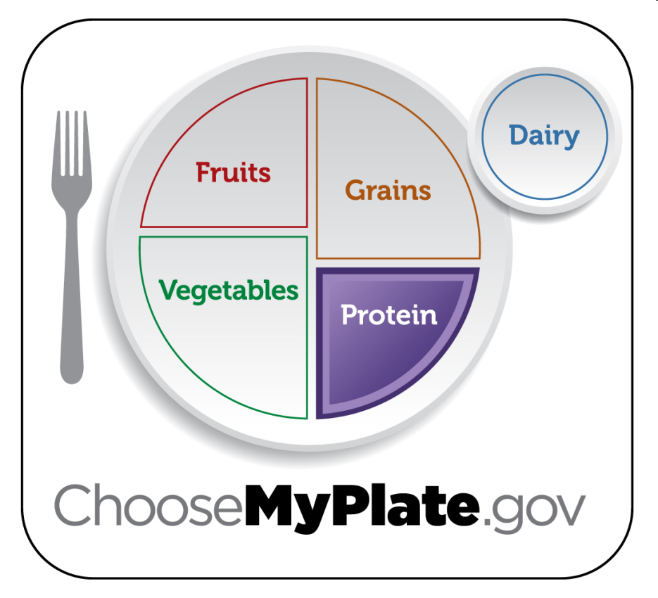
Protein Group
Choose a variety of different protein sources.
In place of some meat and poultry, choose 8 oz. seafood per week.
Try grilling, broiling, poaching or roasting.
Key Consumer Message:
Keep meat and poultry portions small and lean.
Boys 9-13 | 5 oz. daily
Boys 14-18 | 6 ½ oz. daily
Girls 9-18 | 5 oz. daily
Notes:
All foods made from meat, poultry, seafood, beans and peas, eggs, processed soy products, nuts and seeds are considered part of the protein food group. Beans and peas are also part of the vegetable group.
Select a variety of protein foods to improve nutrient intake and health benefits, including at least 8 oz. of cooked seafood per week.
Examples:
Meats: lean cuts of beef, ham, pork or veal
Eggs
Beans and Peas
Processed Soy Products: tofu, veggie burgers, TVP (Textured Vegetable Protein)
Poultry: chicken, duck, goose, turkey
Nuts and Seeds: almonds, cashews, peanuts, sesame seeds, walnuts
Seafood: catfish, cod, flounder, halibut, salmon, tuna, trout
Shellfish and Canned Fish: clams, crabs, lobsters, shrimp, calamari, anchovies, sardines
*The serving amounts indicated on the chart above are appropriate for individuals who get less than 30 minutes per day of moderate physical exercise beyond normal daily activities. Those who are more physically active may be able to consumer more while staying within calorie needs.
*The serving amounts indicated on the chart above are appropriate for individuals who get less than 30 minutes per day of moderate physical exercise beyond normal daily activities. Those who are more physically active may be able to consumer more while staying within calorie needs.

Slide 6
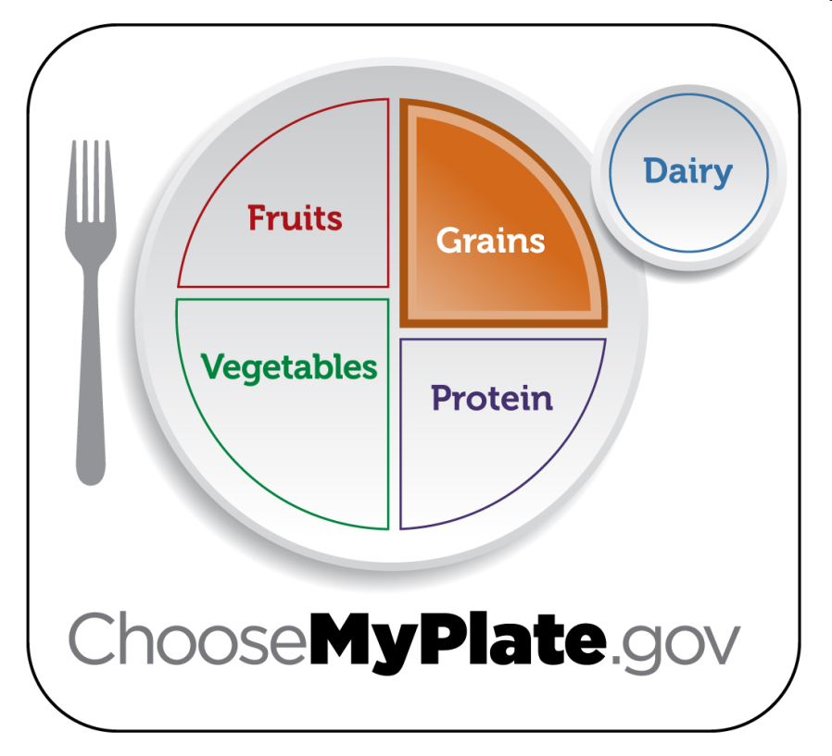
Grains Group
Choose 100% whole grain cereals, breads, crackers, rice and pasta.
Check the ingredients list on food packages for whole grain.
Key Consumer Message:
Make half your grains whole grains.
 | Grains | Whole Grains
Boys 9-13 | 6 oz. daily | 3 oz. daily
Boys 14-18 | 8 oz. daily | 4 oz. daily
Girls 9-13 | 5 oz. daily | 2.5 oz. daily
Girls 14-18 | 6 oz. daily | 3 oz. daily
Notes:
Grains are divided into two subgroups:
Whole Grains: contain the entire grain kernel (bran, germ and endosperm)
Examples: whole wheat flour, cracked wheat, oatmeal, brown rice
Refined Grains: have been milled (a process that removes the bran and germ). This is done to give grains a finer texture and improve their shelf life, but it also removes dietary fiber, iron and many B-Vitamins.
Examples: white flour, white rice, spaghetti, pretzels, crackers, breakfast cereals
*Note: Most refined grains are enriched. This means certain B-Vitamins and Iron are added back in after processing.
*The serving amounts indicated on the chart above are appropriate for individuals who get less than 30 minutes per day of moderate physical exercise beyond normal daily activities. Those who are more physically active may be able to consumer more while staying within calorie needs.

Slide 7
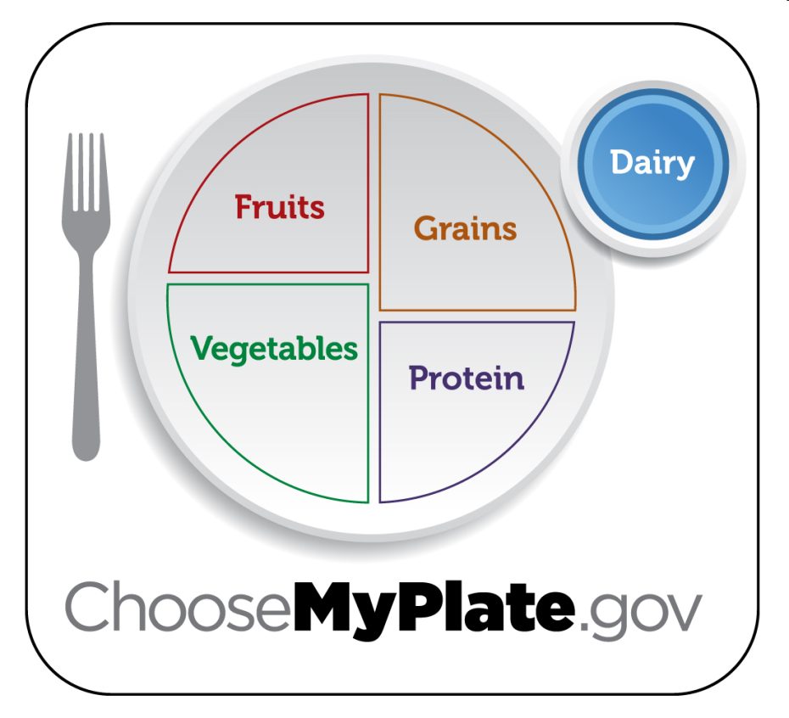
Dairy Group
Low-fat or fat-free dairy products have the same amount of calcium and other essential nutrients as whole milk, but less fat and calories.
Key Consumer Message:
Switch to low-fat or fat-free milk. Get your calcium rich foods.
Boys 9-18 | 3 c. daily
Girls 9-18 | 3 c. daily
Notes:
All fluid milk products and many foods made from milk are considered part of this group.
Foods made from milk that retain their calcium content are part of this group.
Examples: milk, flavored milks, yogurt, milk based desserts, cheese
Foods made from milk that have little or no calcium such as cream cheese, cream and butter, are not considered part of this group.
*The serving amounts indicated on the chart above are appropriate for individuals who get less than 30 minutes per day of moderate physical exercise beyond normal daily activities. Those who are more physically active may be able to consumer more while staying within calorie needs.

Slide 8
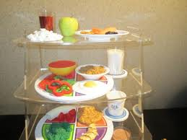
ACTIVITY
INDIVIDUAL:
REMAKE YOUR PLATE OF FOOD WITH HEALTHY CHOICES WHAT DOES YOUR MEAL INCLUDE NOW?
GROUP:
CHOOSE THE BEST MEAL FROM YOUR GROUP AND PRESENT IT TO THE CLASS.
IN YOUR ASSIGNED FOOD GROUP WRITE 3 WISE CHOICES TO INCLUDE IN AN IDEAL DIET.
MYPLATE OVERVIEW

Slide 9
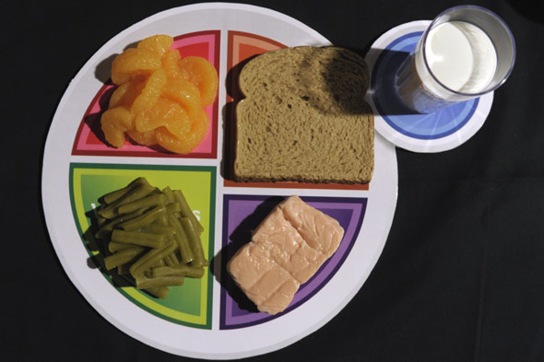
MYPLATE SONG
WHAT ARE SOME CHALLENGES THAT WE MAY FACE WHEN TRYING TO ADOPT MYPLATE PRACTICES?

Slide 10
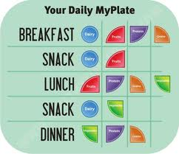
DAILY FOOD MAP

